Slide 1
GPIODVS General Purpose Intra-Operation Dynamic Voltage Scaling
Daniel Moore
November 3rd, 2016

Slide 2
Agenda
Problem Definition + Abstract
PEGMA + IODVS
PRIME
STM32F429 Discovery Board
ADSM300-F
PPS-330D
DEB429A
PACER (T, E, C)
Conclusions + Future Work

Slide 3
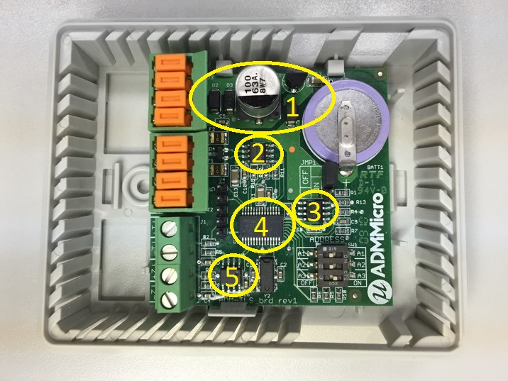
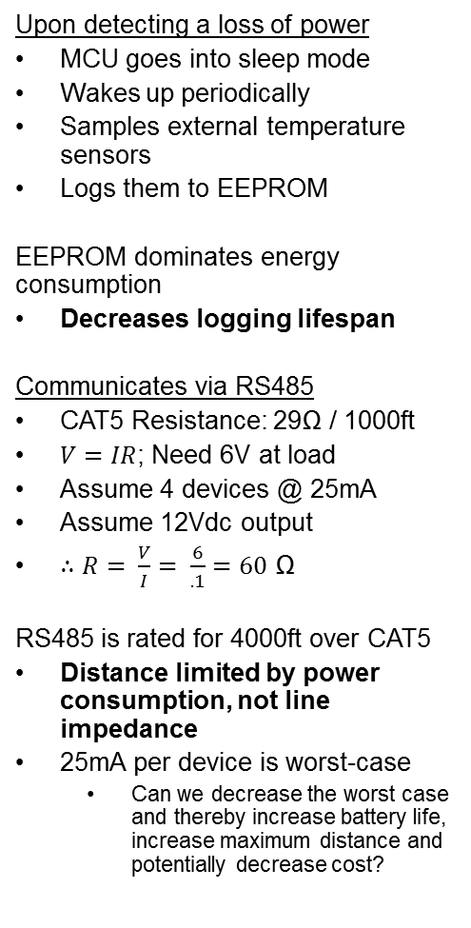
Motivating Example: Logging Sensor
Upon detecting a loss of power
MCU goes into sleep mode
Wakes up periodically
Samples external temperature sensors
Logs them to EEPROM
EEPROM dominates energy consumption
Decreases logging lifespan
Communicates via RS485
CAT5 Resistance: 29Ω / 1000ft
$V=IR$; Need 6V at load
Assume 4 devices @ 25mA
Assume 12Vdc output
$∴R= \frac{V}{I}= \frac{6}{.1}=60$ Ω
RS485 is rated for 4000ft over CAT5
Distance limited by power consumption, not line impedance
25mA per device is worst-case
Can we decrease the worst case and thereby increase battery life, increase maximum distance and potentially decrease cost?
Commercial / Industrial Temperature Logger
Power Supply
RS485 Communications
Non-Volatile Storage (EEPROM)
Micro-controller
Analog Input

Slide 4
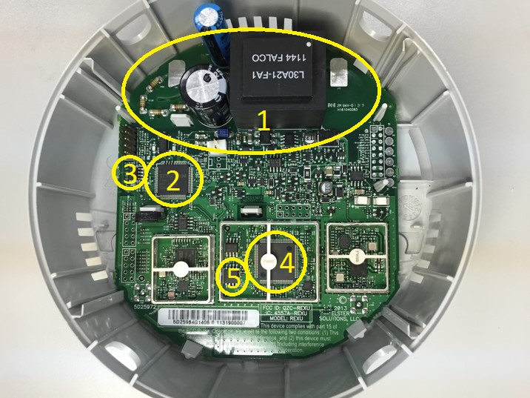
Motivating Example: Electricity Meter
Metrology MCU
Uses EEPROM
Energy Usage
Demand Intervals
Profile Information
NV-RAM
Communications MCU
Uses Serial flash
Network routing data
Firmware Updates
NV-RAM
Capacitor allows the system to run for a period of time after power fails
Residential / Commercial Electricity Meter
Power Supply / Metering
Metering MCU
Metering EEPROM
Communications MCU
Communications Serial Flash

Slide 5
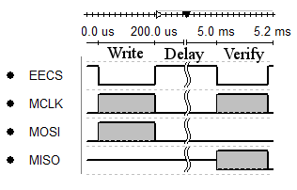
NV-RAM Functionality
Some values need to be updated constantly and preserved across power failures
Typically indexes into logs
Energy accumulations
Status information
EEPROM has a limited write-cycle count (~1,000,000)
Serial flash is typically ~100,000
Solution: Use RAM, and interrupt to back it up as power fail occurs
Requires a capacitor capable of holding Vdd while backup is in progress
Actual communication is only 7.7% of the total write time. The other 92.3% is a mandatory wait period imposed by the chip ‘page-write time’
How can we decrease the energy consumed during the page write time?
Storage capacity is best described as energy limited!
Maximum Clock Frequency
MCP25AA512 SPI EEPROM
20 MHz (4.5 ≤ V_{cc} ≤ 5.5)
10 MHz (2.5 ≤ V_{cc} ≤ 5.5)
2 MHz (1.8 ≤ V_{cc} ≤ 5.5)
Numonyx M25PX16
75/33 MHz (2.7 ≤ V_{cc} ≤ 3.6)
50/25 MHz (2.3 ≤ V_{cc} ≤ 2.7)
Comms speed is voltage-dependent
Write delays are voltage-independent

Slide 6
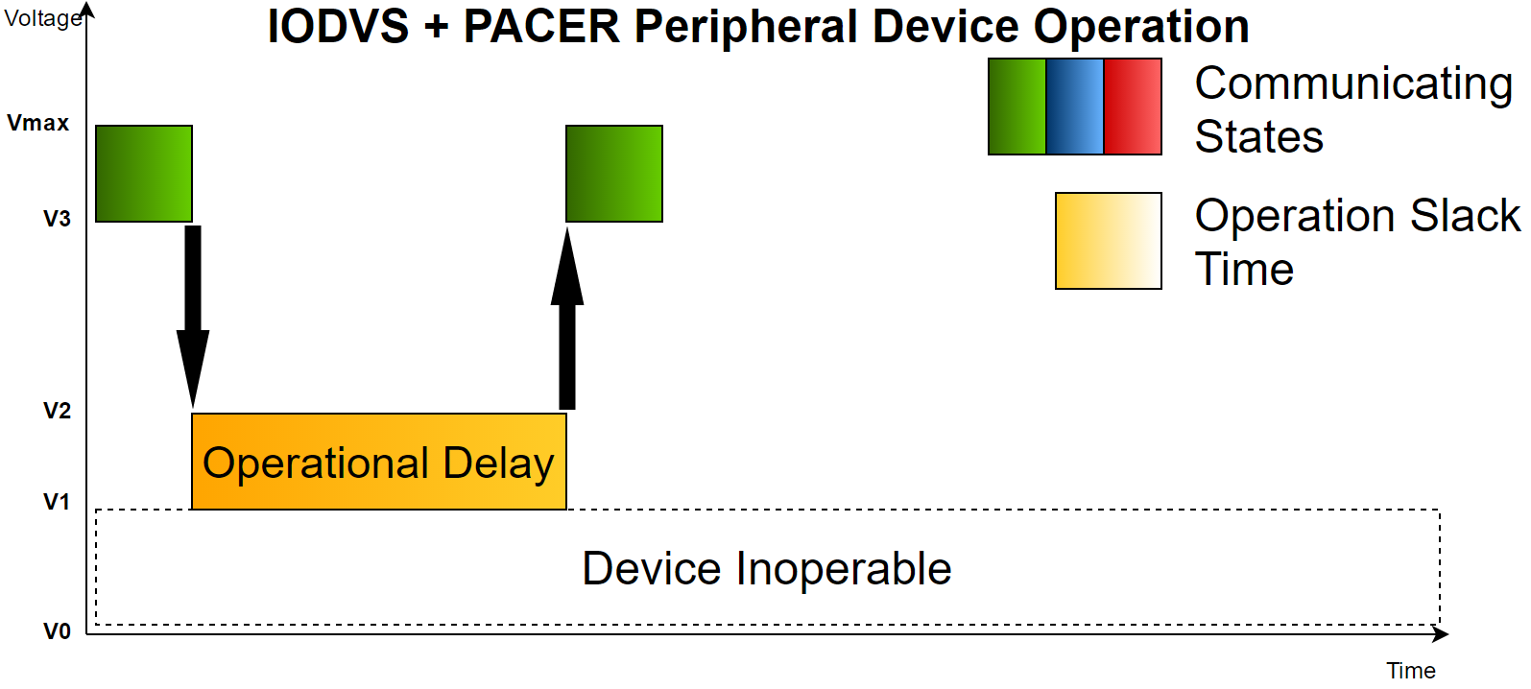
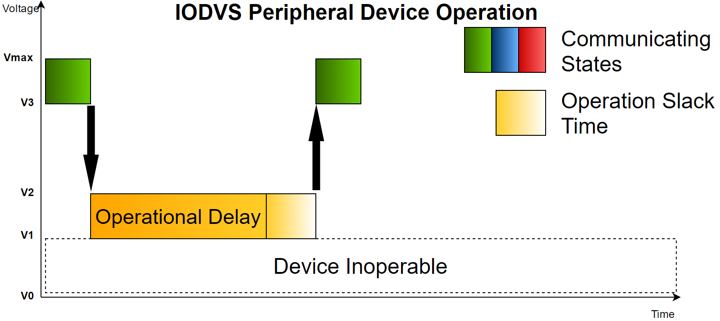
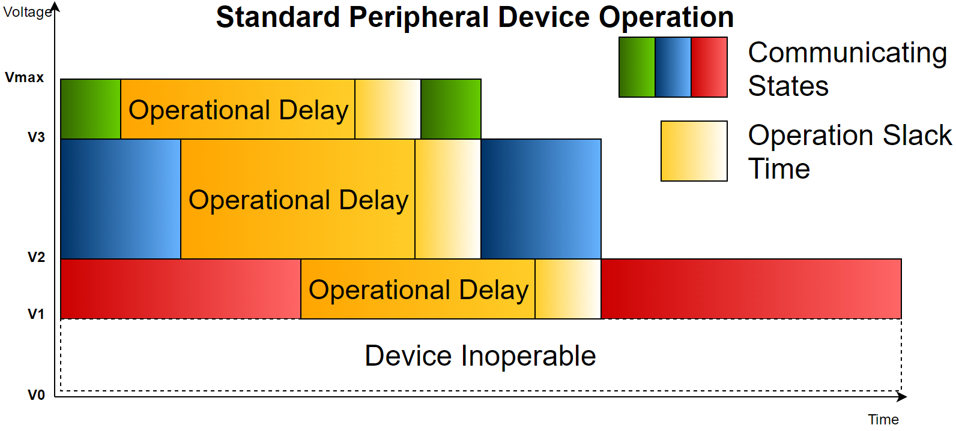
Abstract
Peripheral devices in embedded systems are designed to include slack in both supply voltage and execution time.
GPIODVS exploits both types of slack in order to decrease both energy consumption and latency.

Slide 7
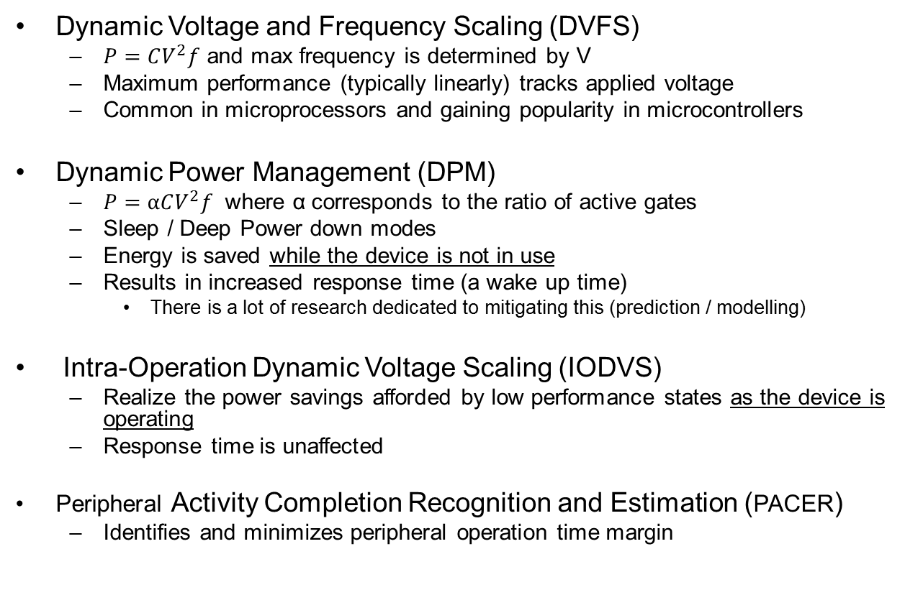
Related Work / Objectives
Dynamic Voltage and Frequency Scaling (DVFS)
$P=CV^{2}f$ and max frequency is determined by V
Maximum performance (typically linearly) tracks applied voltage
Common in microprocessors and gaining popularity in microcontrollers
Dynamic Power Management (DPM)
$P=αCV^{2}f$ where α corresponds to the ratio of active gates
Sleep / Deep Power down modes
Energy is saved while the device is not in use
Results in increased response time (a wake up time)
There is a lot of research dedicated to mitigating this (prediction / modelling)
Intra-Operation Dynamic Voltage Scaling (IODVS)
Realize the power savings afforded by low performance states as the device is operating
Response time is unaffected
Peripheral Activity Completion Recognition and Estimation (PACER)
Identifies and minimizes peripheral operation time margin

Slide 8
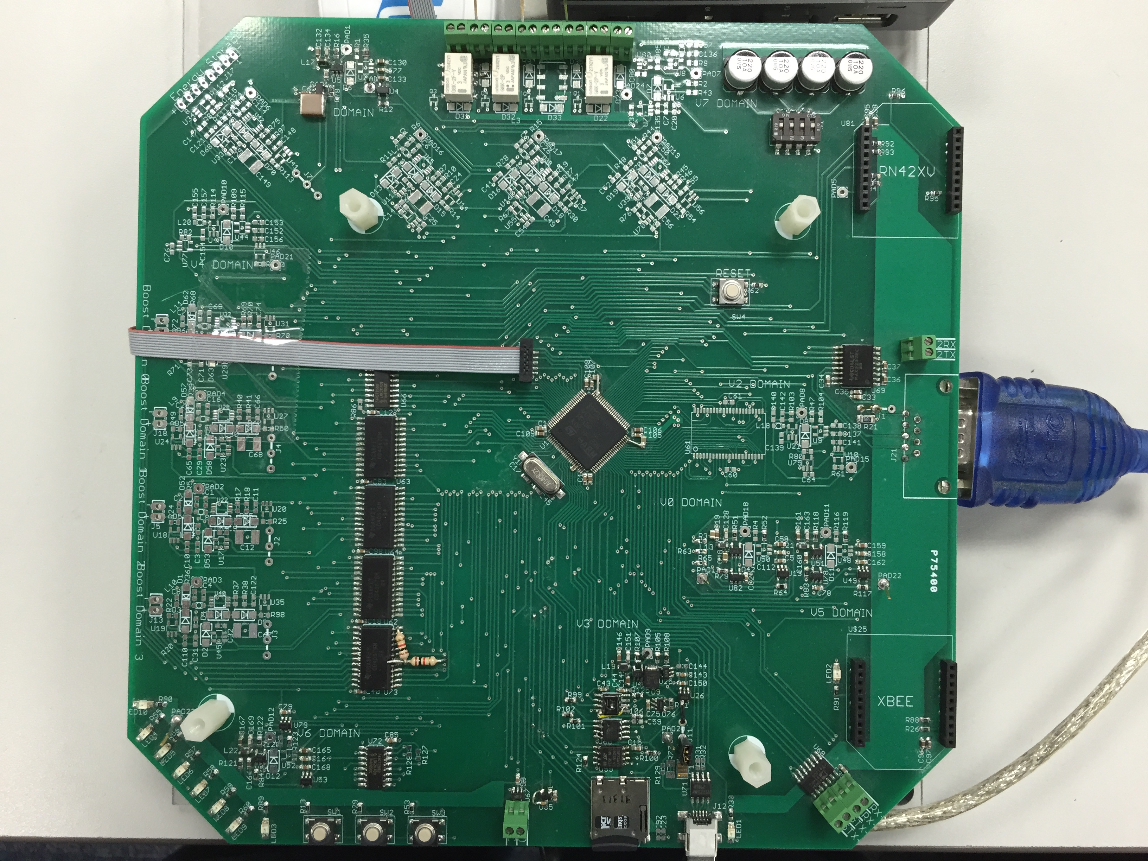
IODVS How: PEGMA
Peripheral Energy Generation Measurement and Allocation
4x + 1 input (boost) SMPS
3x output boost SMPS
8 independently adjustable buck SMPS domains
MCU: STM32F205
2x 10-bit DAC
3x 12-bit ADC (2 MSPS per)
Analog
SRAM
SPI Peripherals
EEPROM
Serial Flash
Temp/Humidity Sensor
Micro-SD Card
Battery Charging
Communications
RS232
RS485
Bluetooth
Zigbee
LEDs / Pushbuttons
Relays
I/O Voltage and Current Measurement on each SMPS
Effectively sub-metering the board
Allows us to measure efficiency

Slide 9
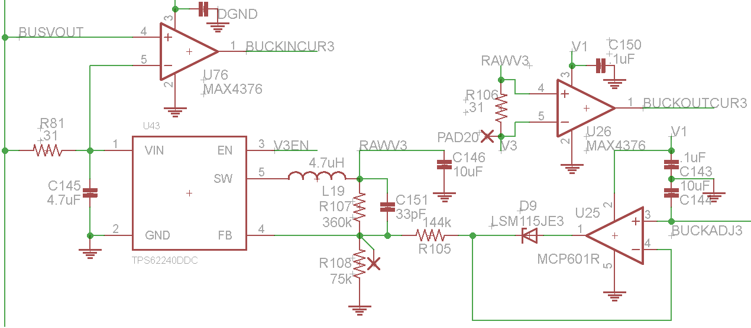
Adjustable SMPS + Current Measurement
TPS62240 efficient at light loads
~80% at 1mA
I/O current measured by MAX4376
“High Side” sense resistor is used, differential across is multiplied by the amplifier gain
2MHz GBP, G = 20
Output Voltage modulated by current into the FB pin
Therefore D9 allows the SMPS to enter a ‘default’ state
And U25 / R105 allow FB current to be modulated by BUCKADJ3
C144 holds the adjustment voltage so that other domains can be ‘refreshed’ in round robin fashion

Slide 10
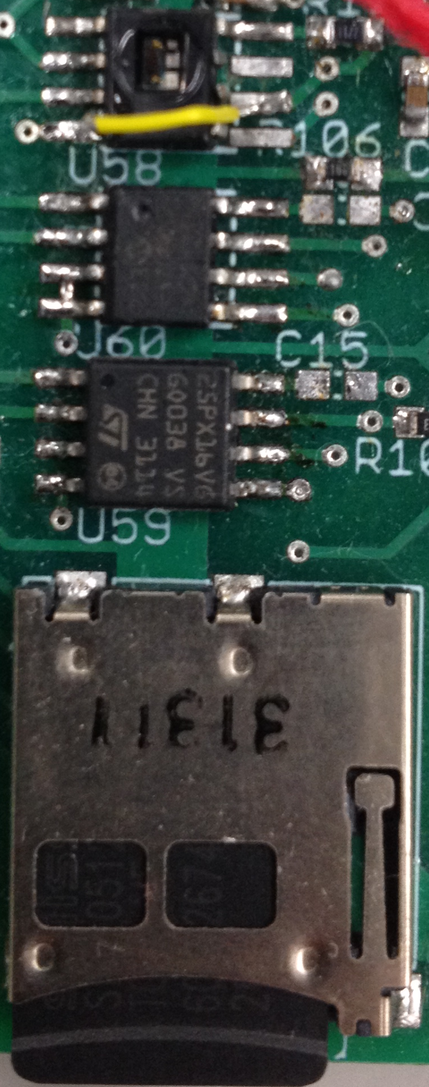
Peripheral Domain
Honeywell HIH6130 (I²C) Temperature/Humidity Sensor
Vmax: 5.5V
Vmin: 2.3V
Microchip 25AA512 EEPROM
Vmax: 5.5V (20MHz)
Vmin: 1.8V (2MHz)
Numonyx M25PX16 (16Mbit)
Vmax: 3.6V (50MHz)
Vmin: 2.3V (25MHz)
SPI Mode SD Cards
Lexar SDSC: 1.0GB
Sandisk: SDSC 1.0GB
Swissbit: SDSC 512MB
Kingston: SDSC 2.0GB
Vmax: 3.6V
Vmin: 2.7V (operating)
Vmin: 2.0V (Idle/Read)

Slide 11
Assumptions and Methods
Assumptions
Measurements are for the set of peripherals (not individually metered)
Only Datasheet specifications form the peripheral power profile
Matched signaling voltages between MCU and peripheral
Test setup
Tests use random data and addresses for memory devices
Average 2048 test results
Should be deterministic as possible
Use as high a sampling frequency as the operation will allow
Buffer size is 10240 samples * 4 channels including state
Therefore a 10ms test can use about a 1us sample rate

Slide 12
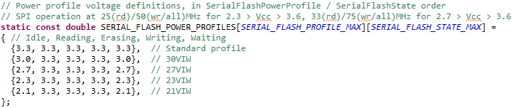
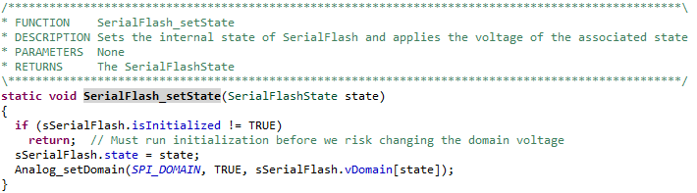
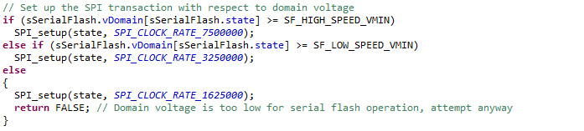
Peripheral Power Profiles
Each device driver contains a lookup table of state-voltage pairs
As the device enters a new state, the voltage is changed to correspond with the requirements of that state
Setup the onboard peripheral to correspond with the ability of the device

Slide 13
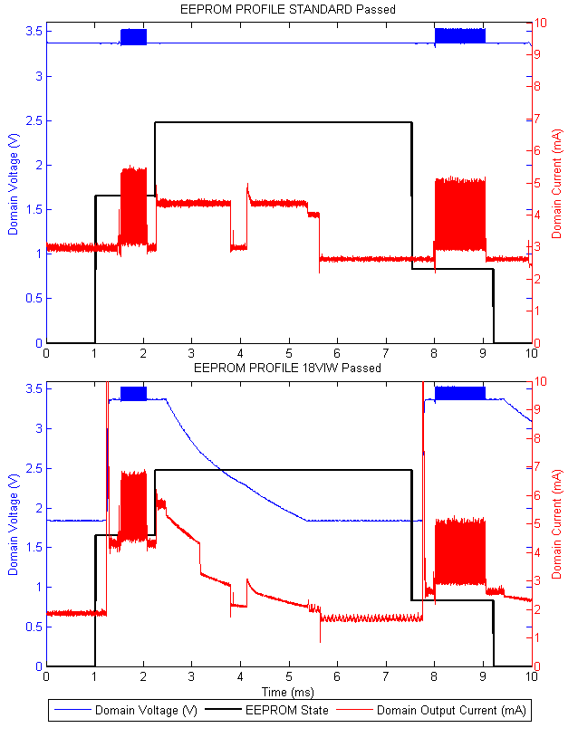
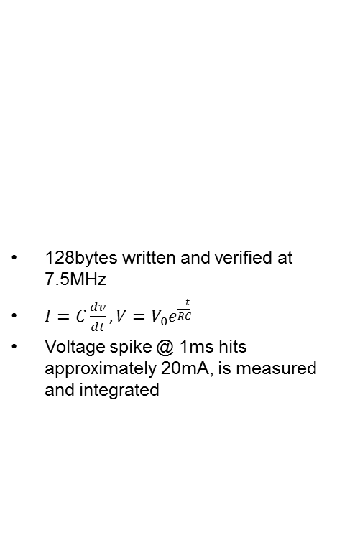
Microchip 25AA512 EEPROM
128bytes written and verified at 7.5MHz
$I=C\frac{dv}{dt}, V=V_{0}e^{\frac{−t}{RC}}$
Voltage spike @ 1ms hits approximately 20mA, is measured and integrated
State | Static (uJ) | IODVS (uJ) | Delta
Idle | 10.24 | 3.49 | -65.91%
Write | 13.79 | 17.85 | 29.47%
Wait | 64.59 | 33.71 | -47.80%
Verify | 17.58 | 17.40 | -1.02%
Idle | 8.81 | 7.96 | -9.57%
Total | 115.02 | 80.43 | -30.07%

Slide 14
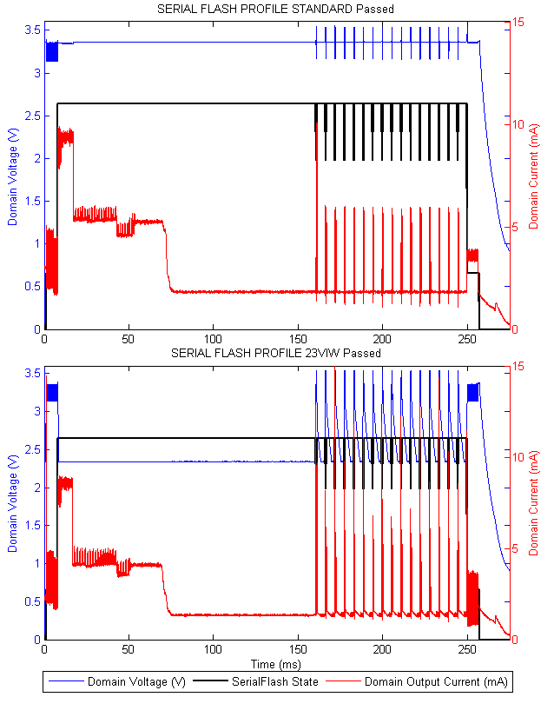
Numonyx 25PX16 Serial Flash
Read 4K subsector, modify 128B within the (cached) subsector
Rewrite the subsector 1 page (256B) at a time
Read the 4K subsector, verify against the cached copy
*Accumulated Write and Wait States
State | Static (uJ) | IODVS (uJ) | Delta
Idle | 10.73 | 5.63 | -47.58%
Read | 71.51 | 72.36 | 1.19%
Erase | 2.47 | 2.47 | -0.13%
Write* | 89.48 | 99.16 | 10.82%
Wait* | 574.84 | 365.75 | -36.37%
Verify | 83.78 | 52.77 | -37.02%
Idle | 38.92 | 38.20 | -1.85%
Total | 2666.18 | 1614.57 | -39.44%

Slide 15
Micro-SD Card (SPI Mode) Write Operation
Power Up
(1ms < t < 35ms)
Initialize
(10ms < t < 1000ms)
Enter / Exit Power Down*
Write Command
(~1ms)
Idle
Poll
(0 < t < 250ms)
Read (Verify)
(~1ms)
Protocol is polling based, making it difficult to conform to our assumption that all communication takes place at the same voltage … but not impossible

Slide 16
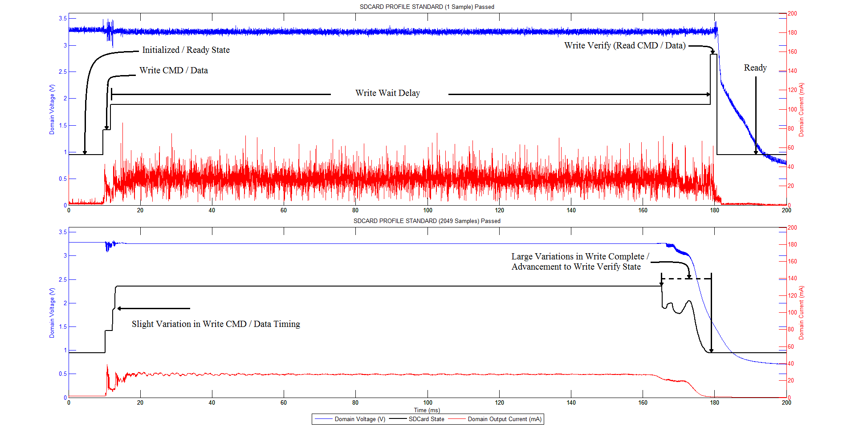
SD-Card Timing Variations
These tests tend to be non-deterministic because of the SD-Card protocol and onboard MMU.
Some operations complete near the 160ms mark, some near the 180ms mark.
Optimizing the wake-up-and-poll time is addressed by PACER

Slide 17
Sandisk Micro-SD Card
Lexar Micro-SD Card
Energy Usage | Static (uJ) | IODVS (uJ) | Delta
Idle | 157.07 | 138.95 | -11.54%
Writing | 26.48 | 26.23 | -0.93%
Waiting | 14021.97 | 10126.95 | -27.78%
Verify | 89.86 | 91.88 | 2.25%
Total | 14295.38 | 10384.02 | -27.36%
Energy Usage | Static (uJ) | IODVS (uJ) | Delta
Idle | 124.09 | 102.41 | -17.47%
Writing | 34.52 | 34.42 | -0.28%
Waiting | 16608.43 | 12558.83 | -24.38%
Verify | 39.45 | 56.87 | 44.17%
Total | 16806.48 | 12752.54 | -24.12%

Slide 18
SwissBit Micro-SD Card
Kingston Micro-SD Card
Energy Usage | Static (uJ) | IODVS (uJ) | Delta
Idle | 66.25 | 43.53 | -34.30%
Writing | 25.01 | 25.72 | 2.85%
Waiting | 3726.20 | 2839.78 | -23.79%
Verify | 74.58 | 72.59 | -2.67%
Total | 3892.04 | 2981.62 | -23.39%
Energy Usage | Static (uJ) | IODVS (uJ) | Delta
Idle | 24.63 | 16.89 | -31.40%
Writing | 89.74 | 91.45 | 1.90%
Waiting | 122.44 | 97.39 | -20.46%
Verify | 54.00 | 57.53 | 6.53%
Total | 290.81 | 263.26 | -9.47%

Slide 19
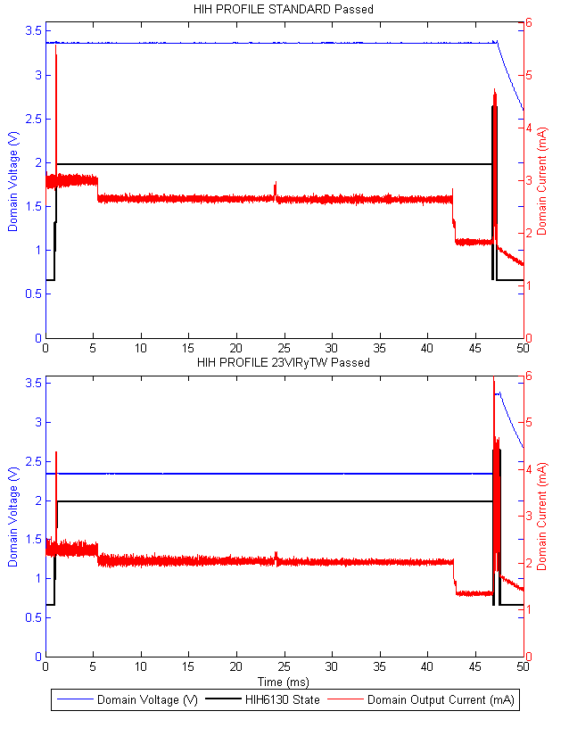
Honeywell HIH6130 Temperature / Humidity Sensor
I²C devices operate in open-collector mode. The bus is pulled to the device Vdd.
Therefore, only reading a response from the device requires matched voltages
Has the added benefit that high voltages increase I2C speed
Energy Usage | Static (uJ) | IODVS (uJ) | Delta
Idle | 10.277369 | 6.2822829 | 61.13%
Command | 1.6786557 | 1.0474309 | 62.40%
Waiting | 399.0716 | 245.89278 | 61.62%
Reading | 4.3045919 | 4.4171913 | 102.62%
Total | 415.33221 | 257.63969 | 62.03%

Slide 20
Comparison
Requirements
Benefits
Requires an adjustable regulator (SMPS realistically)
Adds cost
Potentially adds complexity
Requires some method of modulation
PWM, DAC, Digital Pot., etc.
Requires specific knowledge of peripheral operation
Second-Sourcing may be impacted
Voltage slack is decreased
Cannot poll for completion
Significant energy savings throughout the dominant periods of operation
May benefit cost
May yield better performance
RSM distance
Thermal impact of relays
Regulator modulation can be as simple or as complex as required
Near-zero CPU impact
Near-zero performance impact
Driver retrofit isn’t complex
PACER makes this unnecessary

Slide 21
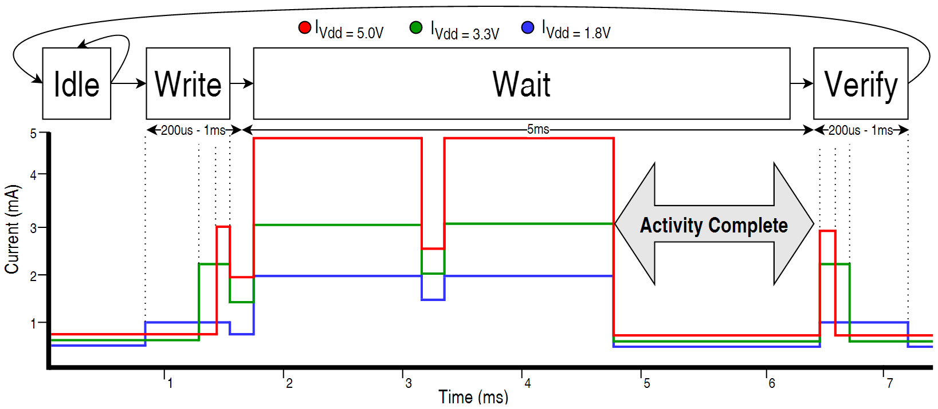
IODVS Observations
Device timing is specified for the worst case per the data sheet. Timing slack exists.
The current profile of most devices indicates early completion
Can we identify early completions to further reduce energy consumption (and reduce latency)?
Via: Time? – Energy? – Current?
Need real-time actionable intelligence!

Slide 22
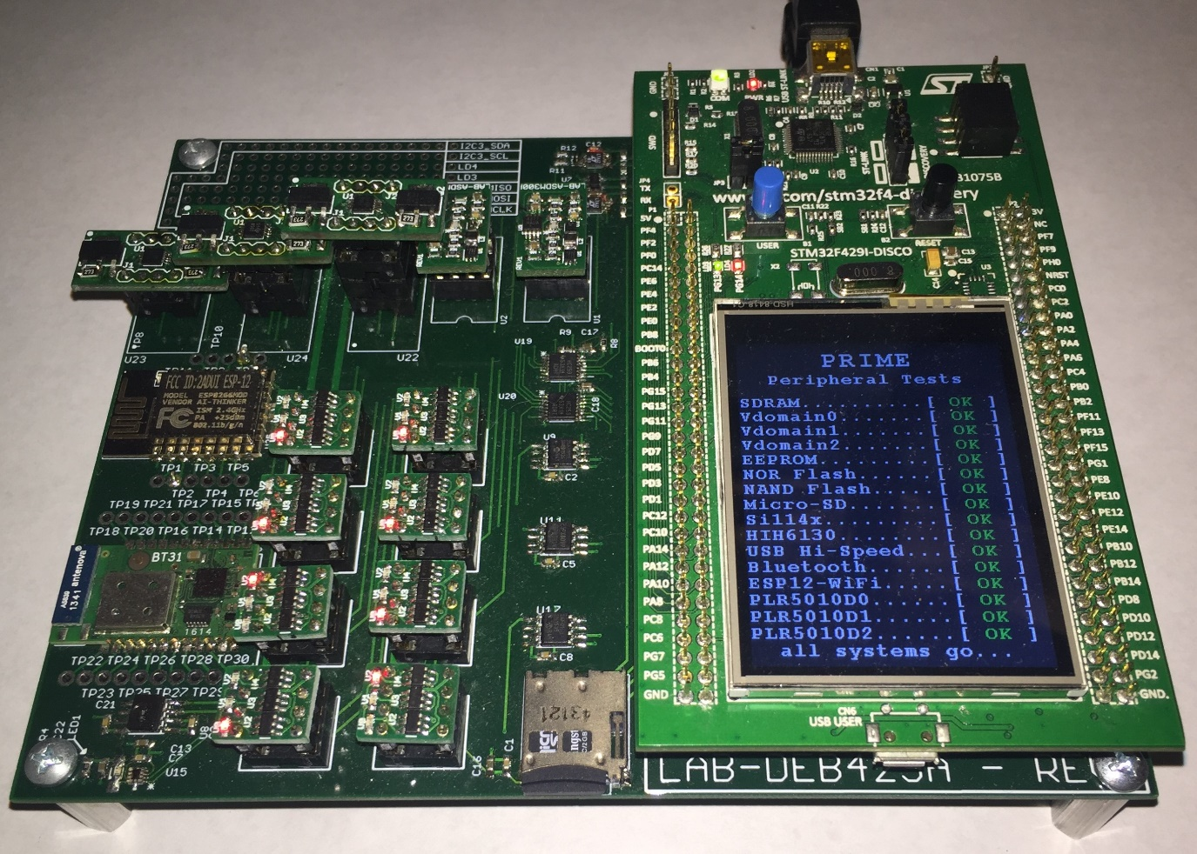
PRIME
Precise Real-time In-circuit Micro Energy management system
Faster MCU: For performing online load analysis
More Memory: More accurate digital integration
More Analog Channels: 3x Domains In/Out Current
Higher Analog SNR: Fine-tuned SMPS design
More Devices: Added NAND Serial Flash
More Bandwidth: Accommodates much higher sampling rates
Peripheral Isolation: More accurate energy savings statistics

Slide 23
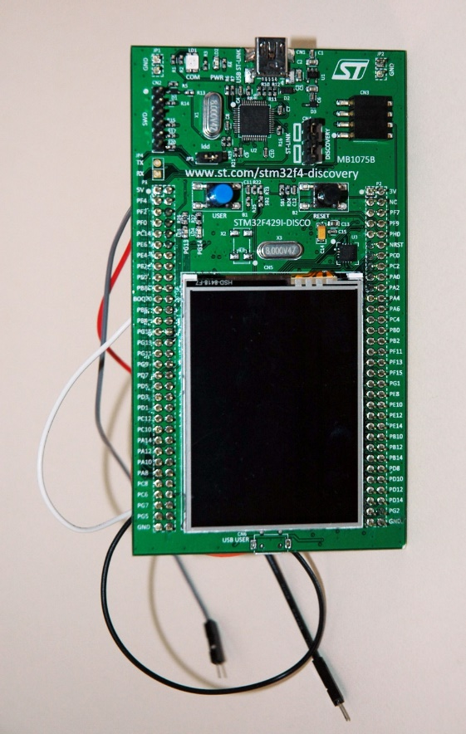
STM32F429 Discovery Board
STM32F429 MCU @ 180MHz
2MB FLASH, 512KB RAM
3x simultaneously sampling ADCs
2.2 MSPS @ 10-bit resolution
Multi-channel DMA + MEM2MEM DMA
On board 64MB SDRAM
On board ST-Link in-circuit debugger
High-accuracy external oscillator
On board push buttons, LEDs and LCD with touch-screen
Access to every MCU pin via a 2x 100mil spaced dual row headers.

Slide 24
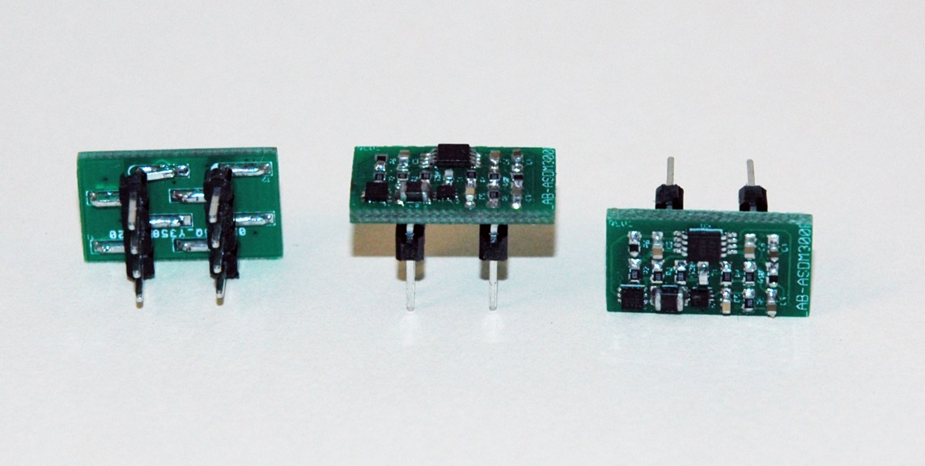
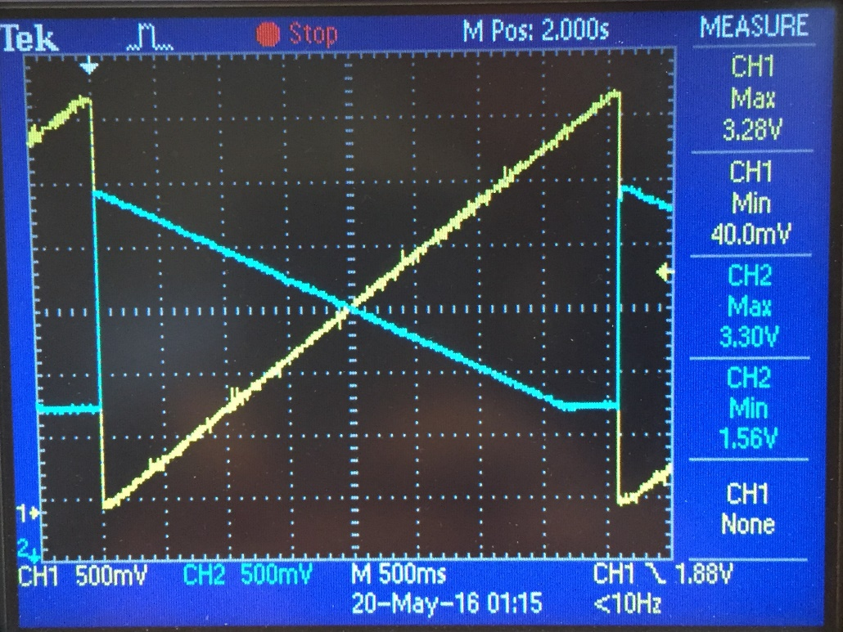
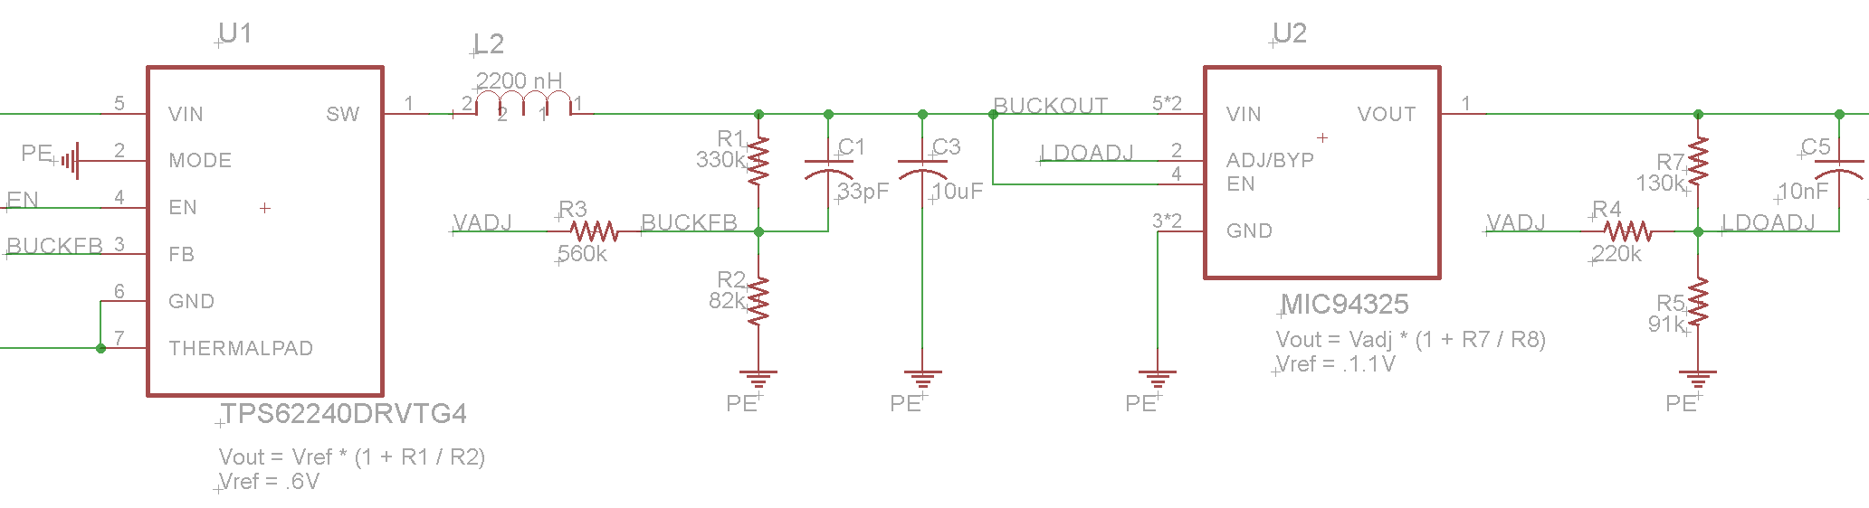
ASDM-300F
Same TPS62240 SMPS as used in PEGMA
Additional Micrel LDO “Ripple-Blocker” regulator for lower switching noise
Lower than 20mvpp → Cannot measure via typical oscilloscope
Dual Channel Current Sense Amplifier MAX4377 (similar to PEGMA)
For simultaneous measurement of input and output current
SMPS and LDO feedback adjust simultaneously
8-Pin DIP Pinout compatible

Slide 25
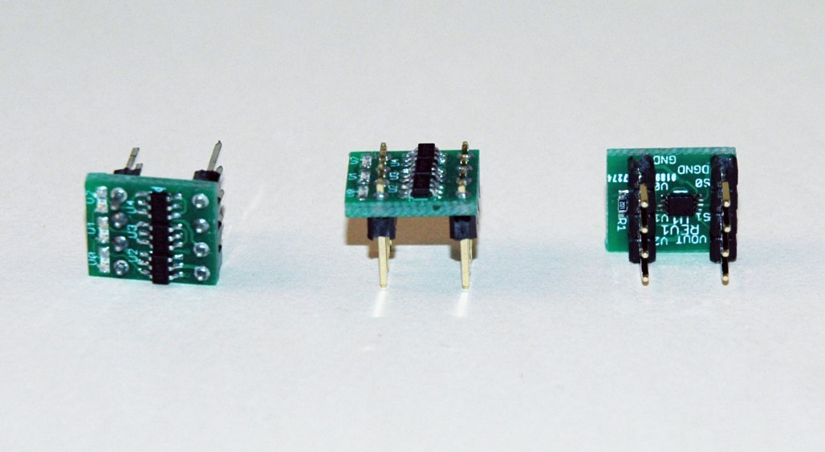
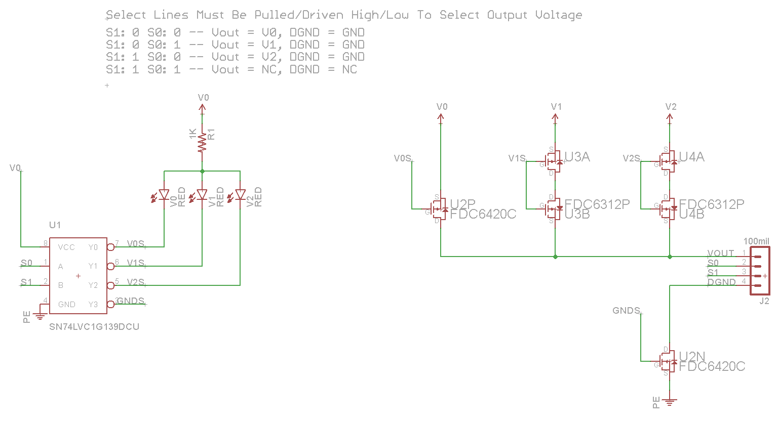
PPS-330D
Uses a 2→4 74HC139 decoder to switch the voltage domain supplied to an external peripheral
Ground can be disconnected entirely
8-Pin DIP pinout compatible

Slide 26
Discovery Expansion Board
Hosts the STM32 Discovery Board
Provides all original PEGMA peripherals and
NAND serial flash
Optical Proximity Sensor
Wi-Fi
Bluetooth
Programmable load regulators
Adds 2 more voltage domains
Peripheral Device Isolation
USB 2.0 Hi-Speed Communication

Slide 27
PACER Peripheral Activity Completion Estimation and Recognition
Use PRIME to detect early completion of peripheral operations
3 Algorithms available:
PACER-T: Time based heuristic
PACER-E: Energy based heuristic
PACER-C: Current based heuristic
Sub-Operations specified as a triplet:
[T1, E1, C1]: Operation is considered complete when ANY of these conditions are satisfied
Operations specified as a set of up to 3 sub-operations:
[[T1, E1, C1], [T2, E2, C2], [T3, E3, C3]]: Suitable for devices like serial flash
Can diversify your metrics among sub-operations!
Use time for sub-op1, energy for sub-op2, etc.

Slide 28
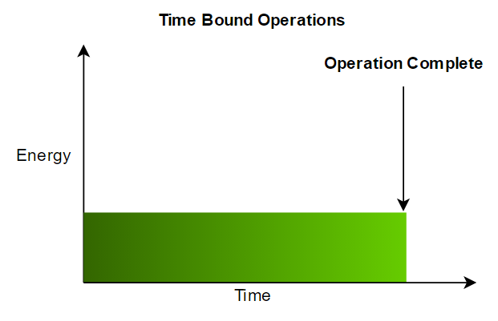
PACER-T Peripheral Activity Completion Estimation and Recognition Time-Based Heuristic
Starts with the delay time as specified in the device data sheet
Successive binary search of success or failure
If the operation succeeded, decrease wait time by 50%
If the operation failed, increase the wait time by 50% of the value between current failure and last success
Ends upon convergence
Result is the lowest marginally stable delay (optimal?)
For this exact device and moment in time and environment

Slide 29
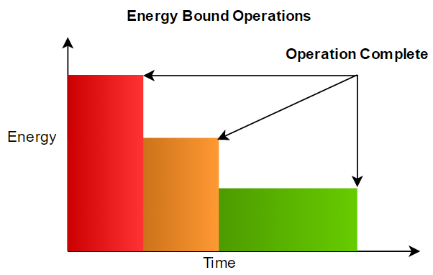
PACER-E Peripheral Activity Completion Estimation and Recognition Energy-Based Heuristic
*Each operation is equal in area
Starts with a guess as to how much energy an operation will consume (in uJ)
Successive binary search of success or failure
If the operation succeeded, decrease wait time by 50%
If the operation failed, increase the wait time by 50% of the value between current failure and last success
Ends upon convergence
Certainly not optimal due at least to analog noise

Slide 30
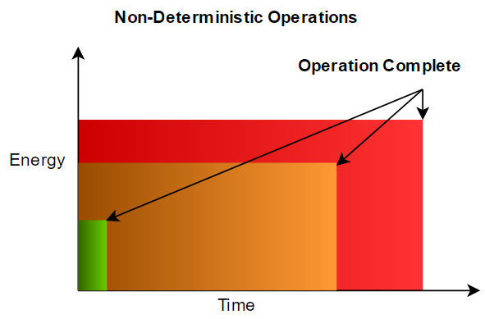
PACER-C Peripheral Activity Completion Estimation and Recognition Current-Based Heuristic
Starts with a current measurement taken before the operation
The operation is executed
The operation is considered complete when the current returns to a supplied multiple of the initial measurement.
Example, supplied multiple = 110, operation is considered complete when current returns to 110% of original measurement
The multiple is important for devices that do not return to idle until a follow-up operation is completed (Sandisk microSD Card)
There is also a (currently hard-coded) minimum operation time
Important for devices that return-to-idle, yet aren’t finished! (EEPROM)

Slide 31
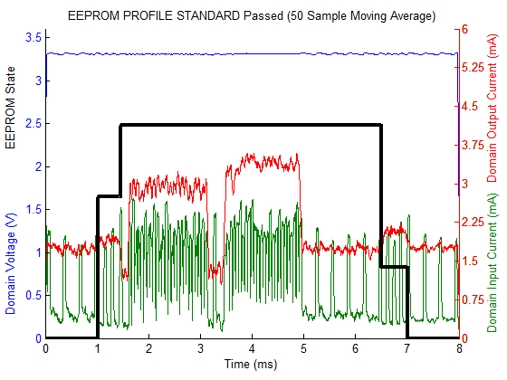
EEPROM PACER-E

Slide 32
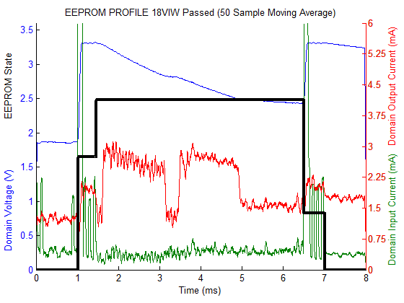
EEPROM PACER-E + IODVS

Slide 33
EEPROM Results
Energy (uJ)
State | Control | IODVS | PACER-T | PACER-T + IODVS | PACER-E | PACER-E + IODVS | PACER-C | PACER-C + IODVS
Idle | 6.03 | 2.47 | 6.04 | 2.52 | 6.06 | 2.47 | 6.13 | 2.48
Writing | 2.71 | 2.55 | 2.73 | 2.51 | 2.69 | 2.50 | 2.80 | 2.58
Waiting | 46.84 | 33.85 | 37.89 | 27.85 | 33.59 | 25.06 | 35.47 | 26.24
Read | 3.50 | 3.48 | 3.29 | 2.04 | 3.51 | 3.49 | 3.55 | 3.21
Idle | 5.89 | 5.76 | 15.30 | 13.42 | 14.97 | 14.16 | 14.50 | 14.03
Test Total | 53.05 | 39.88 | 43.91 | 32.40 | 39.79 | 31.06 | 41.82 | 32.03
Delta | 0.00% | -24.83% | -17.24% | -38.93% | -25.00% | -41.46% | -21.17% | -39.62%
Latency (ms)
State | Control | IODVS | PACER-T | PACER-T + IODVS | PACER-E | PACER-E + IODVS | PACER-C | PACER-C + IODVS
Idle | 1.025 | 1.025 | 1.026 | 1.025 | 1.026 | 1.025 | 1.038 | 1.038
Writing | 0.429 | 0.43 | 0.429 | 0.429 | 0.429 | 0.43 | 0.429 | 0.429
Waiting | 5.045 | 5.044 | 3.508 | 3.507 | 3.54 | 3.508 | 3.603 | 3.653
Read | 0.506 | 0.508 | 0.506 | 0.507 | 0.506 | 0.506 | 0.507 | 0.508
Idle | 0.994 | 0.992 | 2.53 | 2.531 | 2.498 | 2.53 | 2.422 | 2.371
Operation Total | 5.98 | 5.982 | 4.443 | 4.443 | 4.475 | 4.444 | 4.539 | 4.59
Delta | 0.00% | 0.03% | -25.70% | -25.70% | -25.17% | -25.69% | -24.10% | -23.24%
PACER algorithms reduced energy consumption by ~25%
PACER-E appears to be the most effective on its own for this device
PACER + IODVS dramatically reduced energy consumption
PACER algos are within the margin of error to each other for this case

Slide 34
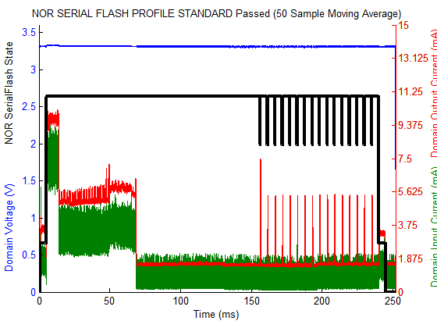
NOR Serial FLASH PACER-T

Slide 35
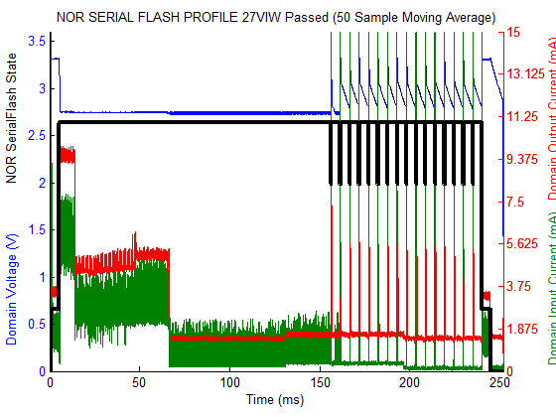
NOR Serial FLASH PACER-T + IODVS

Slide 36
NOR Serial Flash Results
Energy (mJ)
State | Control | IODVS | PACER-T | PACER-T + IODVS | PACER-E | PACER-E + IODVS | PACER-C | PACER-C + IODVS
Idle | 6.04 | 4.66 | 6.05 | 4.61 | 6.07 | 4.65 | 6.15 | 4.63
Reading | 49.99 | 50.08 | 58.08 | 50.21 | 50.13 | 49.89 | 49.87 | 50.14
Erase | 0.95 | 0.96 | 0.91 | 0.94 | 0.96 | 0.97 | 0.99 | 0.95
Total Write | 39.17 | 36.31 | 63.05 | 41.26 | 37.68 | 20.40 | 37.36 | 17.81
Total Wait | 2138.32 | 1713.89 | 1211.99 | 1029.52 | 1501.73 | 1178.32 | 1319.34 | 1040.74
Reading | 48.60 | 48.78 | 51.91 | 31.72 | 48.59 | 33.76 | 48.47 | 42.02
Idle | 37.05 | 33.13 | 929.24 | 711.59 | 689.63 | 576.83 | 859.97 | 657.46
Total No Idle | 2277.02 | 1854.68 | 1391.98 | 1158.26 | 1645.17 | 1287.98 | 1462.18 | 1156.28
Delta | 0.00% | -18.55% | -38.87% | -49.13% | -27.75% | -43.44% | -35.79% | -49.22%
Latency (ms)
State | Control | IODVS | PACER-T | PACER-T + IODVS | PACER-E | PACER-E + IODVS | PACER-C | PACER-C + IODVS
Idle | 1.04 | 1.04 | 1.04 | 1.04 | 1.04 | 1.04 | 1.05 | 1.05
Reading | 4.27 | 4.27 | 4.27 | 4.27 | 4.27 | 4.27 | 4.27 | 4.27
Erase | 0.08 | 0.08 | 0.08 | 0.08 | 0.08 | 0.08 | 0.08 | 0.08
Total Write | 3.31 | 3.32 | 3.31 | 3.32 | 3.31 | 3.32 | 3.31 | 3.32
Total Wait | 231.57 | 231.57 | 69.47 | 66.92 | 104.81 | 120.17 | 80.15 | 79.06
Reading | 4.64 | 4.64 | 4.27 | 4.63 | 4.64 | 4.73 | 4.64 | 4.64
Idle | 7.09 | 7.08 | 169.55 | 171.74 | 133.86 | 118.38 | 158.50 | 159.57
Total No Idle | 243.87 | 244.92 | 82.45 | 80.26 | 118.14 | 133.62 | 93.50 | 92.43
Delta | 0.00% | 0.43% | -66.19% | -67.09% | -51.55% | -45.21% | -61.66% | -62.10%
PACER algorithms reduced energy consumption by ~33%
PACER-T appears to be the most effective on its own for this device
PACER + IODVS dramatically reduced energy consumption + latency
PACER-T + IODVS Reduced latency by 67%, and energy by 49%

Slide 37
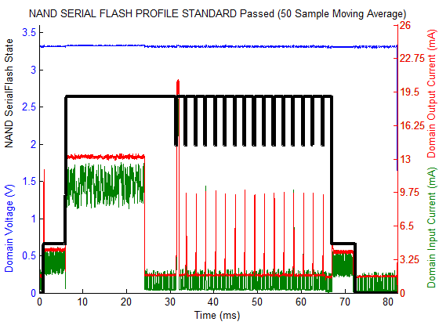
NAND Serial FLASH PACER-T

Slide 38
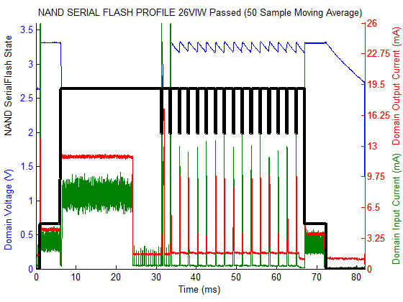
NAND Serial FLASH PACER-T + IODVS

Slide 39
NAND Serial Flash Results
Energy (mJ)
State | Control | IODVS | PACER-T | PACER-T + IODVS | PACER-E | PACER-E + IODVS | PACER-C | PACER-C + IODVS
Idle | 5.62 | 4.12 | 5.54 | 4.07 | 5.58 | 4.08 | 5.64 | 4.14
Reading | 71.49 | 71.57 | 72.58 | 71.52 | 71.45 | 72.10 | 71.54 | 71.39
Erase | 1.58 | 1.59 | 1.53 | 1.58 | 1.55 | 1.49 | 1.55 | 1.52
Total Write | 51.88 | 48.14 | 75.40 | 70.70 | 73.01 | 70.19 | 51.63 | 44.66
Total Wait | 1052.98 | 806.15 | 802.63 | 584.87 | 817.59 | 596.84 | 887.28 | 670.32
Reading | 69.97 | 69.81 | 73.11 | 73.27 | 72.90 | 73.11 | 72.75 | 72.85
Idle | 52.31 | 44.66 | 249.37 | 187.25 | 234.28 | 158.54 | 149.37 | 133.95
Active Total | 1247.90 | 997.26 | 1025.25 | 801.95 | 1036.50 | 813.72 | 1084.76 | 860.73
Delta | 0.00% | -20.08% | -17.84% | -35.74% | -16.94% | -34.79% | -13.07% | -31.03%
Latency (ms)
State | Control | IODVS | PACER-T | PACER-T + IODVS | PACER-E | PACER-E + IODVS | PACER-C | PACER-C + IODVS
Idle | 1.04 | 1.04 | 1.04 | 1.04 | 1.04 | 1.04 | 1.05 | 1.05
Reading | 5.00 | 5.00 | 5.00 | 5.00 | 5.00 | 5.00 | 5.00 | 5.00
Erase | 0.08 | 0.08 | 0.08 | 0.08 | 0.08 | 0.08 | 0.08 | 0.08
Total Write | 3.31 | 3.32 | 3.31 | 3.31 | 3.31 | 3.32 | 3.31 | 3.31
Total Wait | 57.61 | 57.62 | 19.26 | 19.27 | 25.92 | 25.92 | 36.19 | 36.20
Reading | 5.28 | 5.28 | 5.29 | 5.29 | 5.28 | 5.28 | 5.28 | 5.29
Idle | 9.68 | 9.67 | 48.02 | 48.01 | 41.37 | 41.36 | 31.09 | 31.07
Active Total | 71.28 | 71.29 | 32.94 | 32.95 | 39.59 | 39.60 | 49.86 | 49.87
Delta | 0.00% | 0.01% | -53.79% | -53.78% | -44.46% | -44.45% | -30.05% | -30.03%
PACER algorithms reduced energy consumption by ~15%
PACER-T appears to be the most effective on its own for this device
PACER + IODVS dramatically reduced energy consumption + latency
PACER-T + IODVS Reduced latency by 54%, and energy by 36%

Slide 40
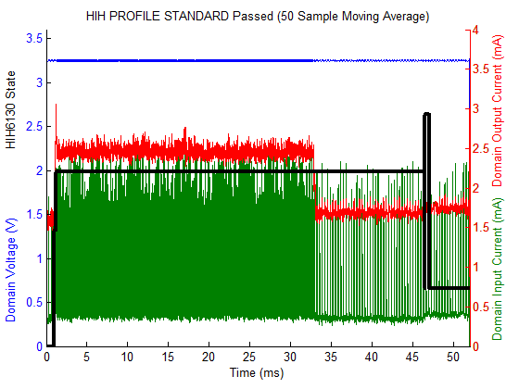
HIH-6130 Environment Sensor PACER-T

Slide 41
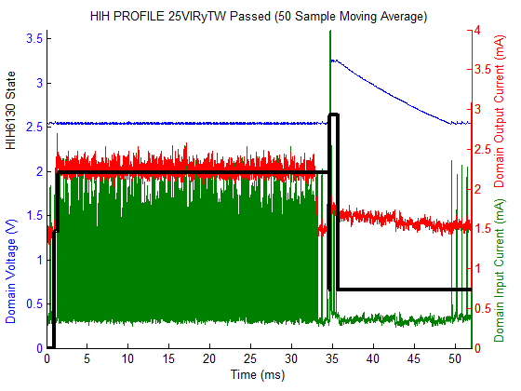
HIH-6130 Environment Sensor PACER-T + IODVS

Slide 42
HIH-6130 Results
Energy (mJ)
State | Control | IODVS | PACER-T | PACER-T + IODVS | PACER-E | PACER-E + IODVS | PACER-C | PACER-C + IODVS
Idle | 5.19 | 3.60 | 5.28 | 3.64 | 5.24 | 3.62 | 5.33 | 3.67
Writing | 1.75 | 0.98 | 1.76 | 0.93 | 1.73 | 0.98 | 1.76 | 1.00
Waiting | 325.95 | 231.17 | 254.14 | 120.39 | 240.29 | 169.62 | 223.65 | 159.00
Idle | 0.08 | 0.05 | 0.09 | 0.05 | 0.12 | 0.10 | 0.09 | 0.05
Reading | 2.80 | 2.64 | 2.98 | 3.10 | 3.37 | 3.30 | 2.95 | 2.92
Idle | 28.04 | 26.18 | 105.49 | 83.50 | 106.34 | 84.62 | 105.31 | 83.60
Active Total | 330.50 | 234.79 | 258.88 | 124.41 | 245.39 | 173.89 | 228.36 | 162.91
% Decrease | 0.00% | 28.96% | 21.67% | 62.36% | 25.75% | 47.39% | 30.91% | 50.71%
Latency (ms)
State | Control | IODVS | PACER-T | PACER-T + IODVS | PACER-E | PACER-E + IODVS | PACER-C | PACER-C + IODVS
Idle | 1.01 | 1.01 | 1.01 | 1.01 | 1.01 | 1.01 | 1.03 | 1.03
Writing | 0.23 | 0.44 | 0.23 | 0.44 | 0.23 | 0.44 | 0.23 | 0.44
Waiting | 45.27 | 45.27 | 31.66 | 31.44 | 31.45 | 31.41 | 31.70 | 31.60
Idle | 0.01 | 0.01 | 0.01 | 0.01 | 0.01 | 0.01 | 0.01 | 0.01
Reading | 0.49 | 0.95 | 0.49 | 0.95 | 0.49 | 0.95 | 0.49 | 0.95
Idle | 4.98 | 4.32 | 18.59 | 18.15 | 18.80 | 18.18 | 18.54 | 17.98
Active Total | 45.99 | 46.65 | 32.38 | 32.82 | 32.17 | 32.80 | 32.42 | 32.98
% Decrease | 0.00% | -1.44% | 29.59% | 28.63% | 30.05% | 28.69% | 29.50% | 28.28%
PACER algorithms reduced energy consumption by ~25%
PACER-T appears to be the most effective on its own for this device
PACER + IODVS dramatically reduced energy consumption + latency
PACER-T + IODVS Reduced latency by 54%, and energy by 36%

Slide 43
microSD Cards…
Recall the current profile of the Swissbit microSD Card
2048 averaged samples indicate completions at a wide variety of times!
Indicates onboard caching. We’ll prove it on each device.
Only PACER-C logically makes sense to detect these completions

Slide 44
Caching Example
Typical IODVS write (cache miss)
PACER-C write
cache hit detected

Slide 45
Sandisk Caching Example
Typical IODVS write (cache miss)
PACER-C write
cache hit detected
Note the current multiple

Slide 46
Sandisk microSD Results
PACER-C improvement realizes the energy benefit of cache-hits

Slide 47
Lexar microSD Results

Slide 48
Swissbit microSD Results
PACER-C improvement realizes the energy benefit of HIGHLY variable response times

Slide 49
Kingston microSD Results
PACER-C improvement limited by highly clustered response times, extremely fast operation times, low wait-energy penalty. Still, slightly faster response time

Slide 50
PACER Results / Analysis
Significant energy / latency savings on its own merit
Enhanced further by IODVS and provides completion detection
PACER-T and PACER-C are most effective for the devices tested
PACER-T requires no extra circuitry whatsoever
PACER-E requires analog feedback but is computationally friendly
DMA + MAC units are currently very common on MCU
PACER-C can provide the best performance for highly non-deterministic response times.
May be MCU friendly if specialized ADC HW is available – there currently exists interrupt-on-threshold MCU hardware

Slide 51
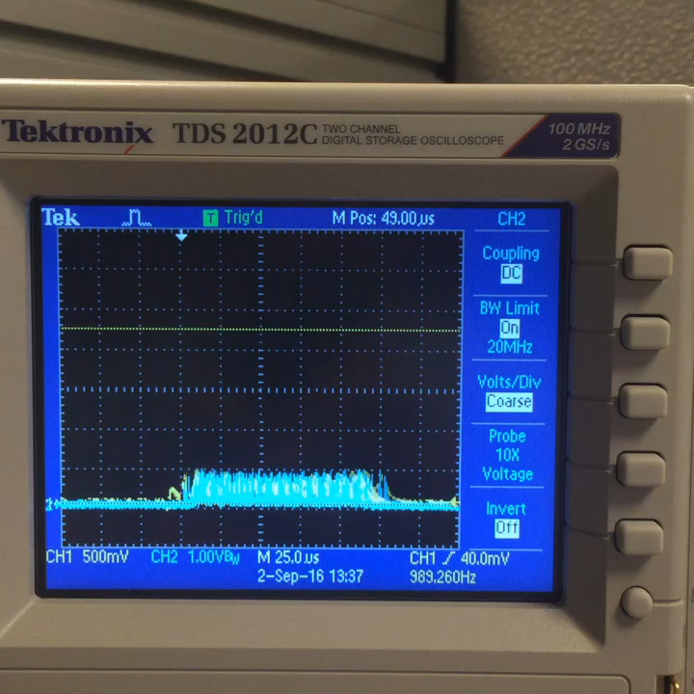
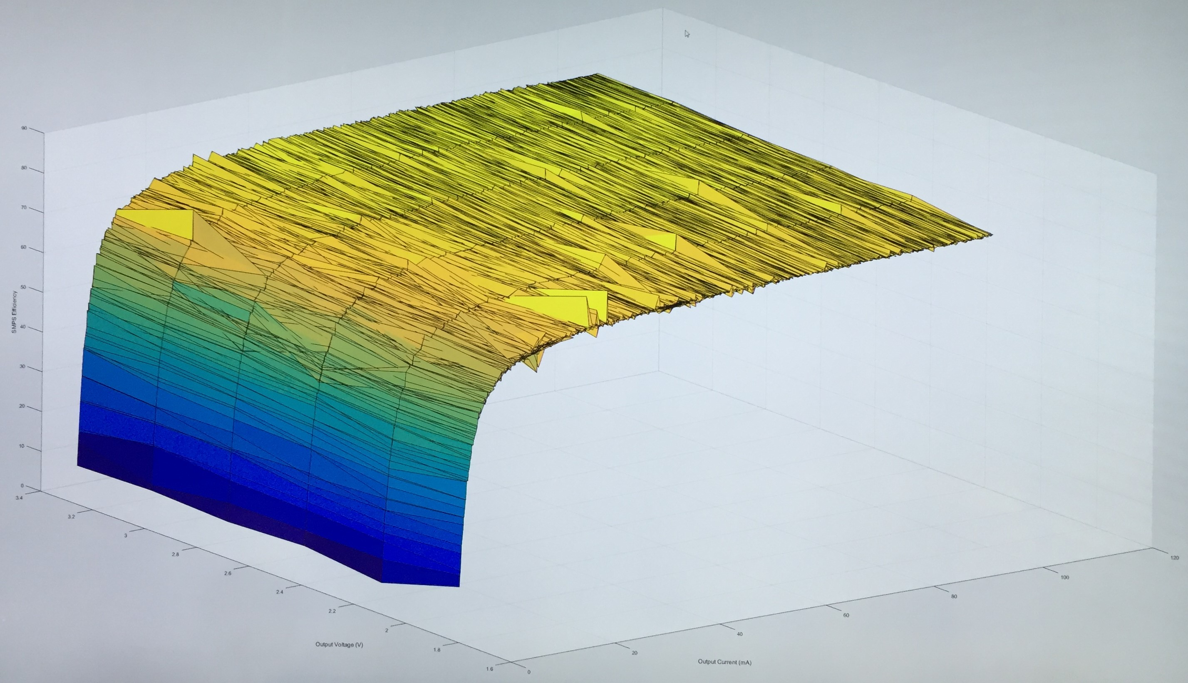
Conclusions / Further Research
The combination of IODVS + PACER is effective
IODVS removes the ability to poll a peripheral for operation completion in exchange for significant energy reduction while maintaining response time
PACER provides an alternative mechanism for detecting complete operations
The best voltages to use need to be researched before design
And with respect to EVERY device on the domain!
Further Research
Supervised IODVS
Mitigating Interference + Voltage Domain Selection
Thank you!

Slide 52
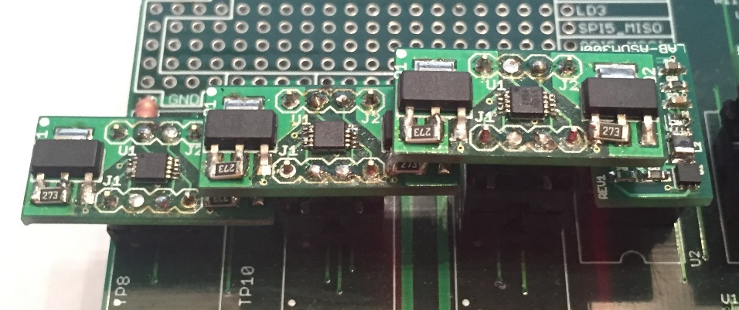
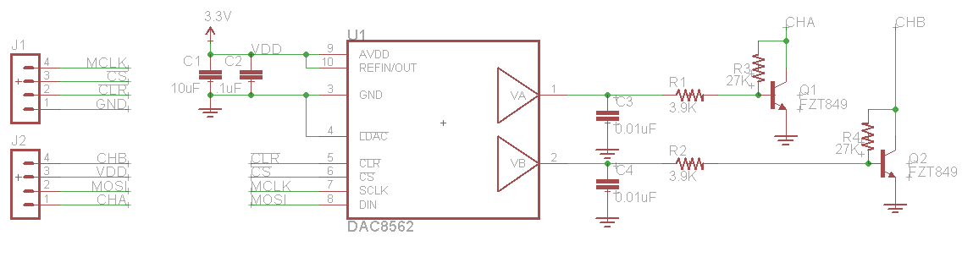
PLR-5010D

Slide 53
Why not compare low-voltage results to IODVS results?
MCU + periph voltages must be matched for comms.
MCU can’t operate at 1.8V @ 180MHz
System under test was not performing DVFS, static 3.3V
Would need to install voltage translators to accomplish the test
Voltage translation costs $, space, energy + time
For MCUs at static voltages it is appropriate to frame the savings as in terms of energy going from high to low, rather than in terms of time going from low to high
EEPROM communication time is increased by 10x per comms
Energy control = 6.25uJ communication / 65uJ total
Would expect that figure to increase to ~62.5uJ comms / 121.25uJ total
Increasing energy by ~28%, increasing latency from 6ms → 9ms (50%)

Slide 54
Polling vs. PACER?
IODVS is impossible with polling
What is the cost of communication?
MCU must stay in active mode?
MCU and peripheral Tx/Rx must stay active
Comms is extremely costly over I2C

